Slide 1


Company Profile
Since 1989

Slide 2


We are equipped to handle almost any sort of metal work. Call us and let us know how we can help. Email address: unitopmetalwire@gmail.com Telephone: 8 986-6572 to 73 Viber: 0923-375-2675
Unitop Metalwire Technologies offer customs metal works and fabrications services which can bring to life your architectural vision.

Slide 3
A more than 30 years in business that combines factory production and wholesale, Unitop Metalwire Technologies actively serves the market by engaging in a variety of activities, including project design, product development, large-scale production, and some on-field building. We are actively serving the Metalwire market in the Philippines, including the NCR, Eastern Visayas, North, and South Luzon markets. Our goals are to "strictly control the quality for survival in the industry and gaining reputation for development of the enterprise" and to continuously expand the local market. Our constant goal is to be honest and prioritize the demands of our customers. Our motto is "serving clients totally and innovating to serve you best." Everyone is invited to stop by and talk about future collaboration. We are eager to collaborate with you in the coming century when the flow of the global economy sweeps us both together to produce something great!
Company Profile

Slide 4

Corporate culture is not something that is brought in from abroad; rather, it is the culmination of many years of cultural experience within the company, and it serves as the theoretical foundation for guiding the company's growth and development.
Business Culture
Quality first, aiming to lead the industry based on moral principles and providing genuine customer service.
Business Objectives

Slide 5
Create chances for employees, value for customers, advantages for businesses and advancement for society.
Business Principle
Consider the following: efficiency at the core, market as the direction, technology as the foundation, and quality as the assurance.
Business Policy

Slide 6
Integrity is the cornerstone of enterprise development, which is the enterprise's enduring theme.
Business Etiquette
We are the source manufacturer: Because we are the source with the best cost control, our products lead the peer group with high quality and affordable prices.
Enterprise Strength

Slide 7

43 Susano Road, Deparo Brgy 170 District 1, Caloocan City Tel No.: 02-8 986-6572; 02-8 986-6573; Cellphone & Viber No.: 0923-375-2675 Email address: unitopmetalwire@gmail.com
OUR PERMITS AND LICENSES

Slide 8
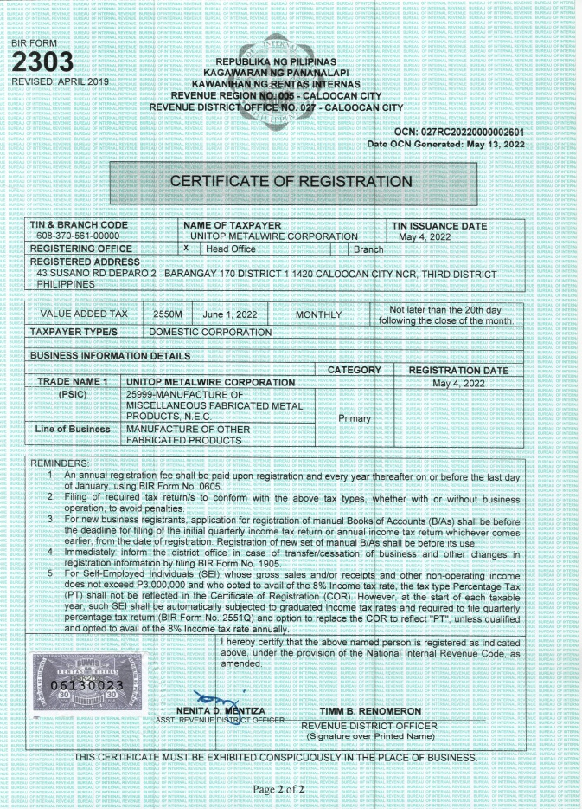
43 Susano Road, Deparo Brgy 170 District 1, Caloocan City Tel No.: 02-8 986-6572; 02-8 986-6573; Cellphone & Viber No.: 0923-375-2675 Email address: unitopmetalwire@gmail.com
OUR PERMITS AND LICENSES

Slide 9
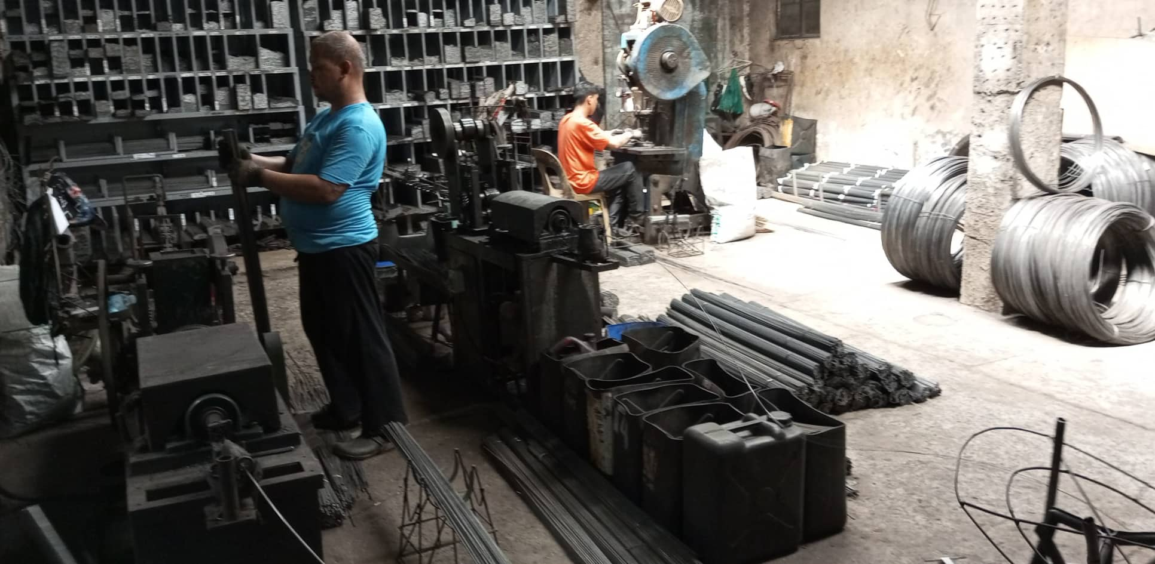
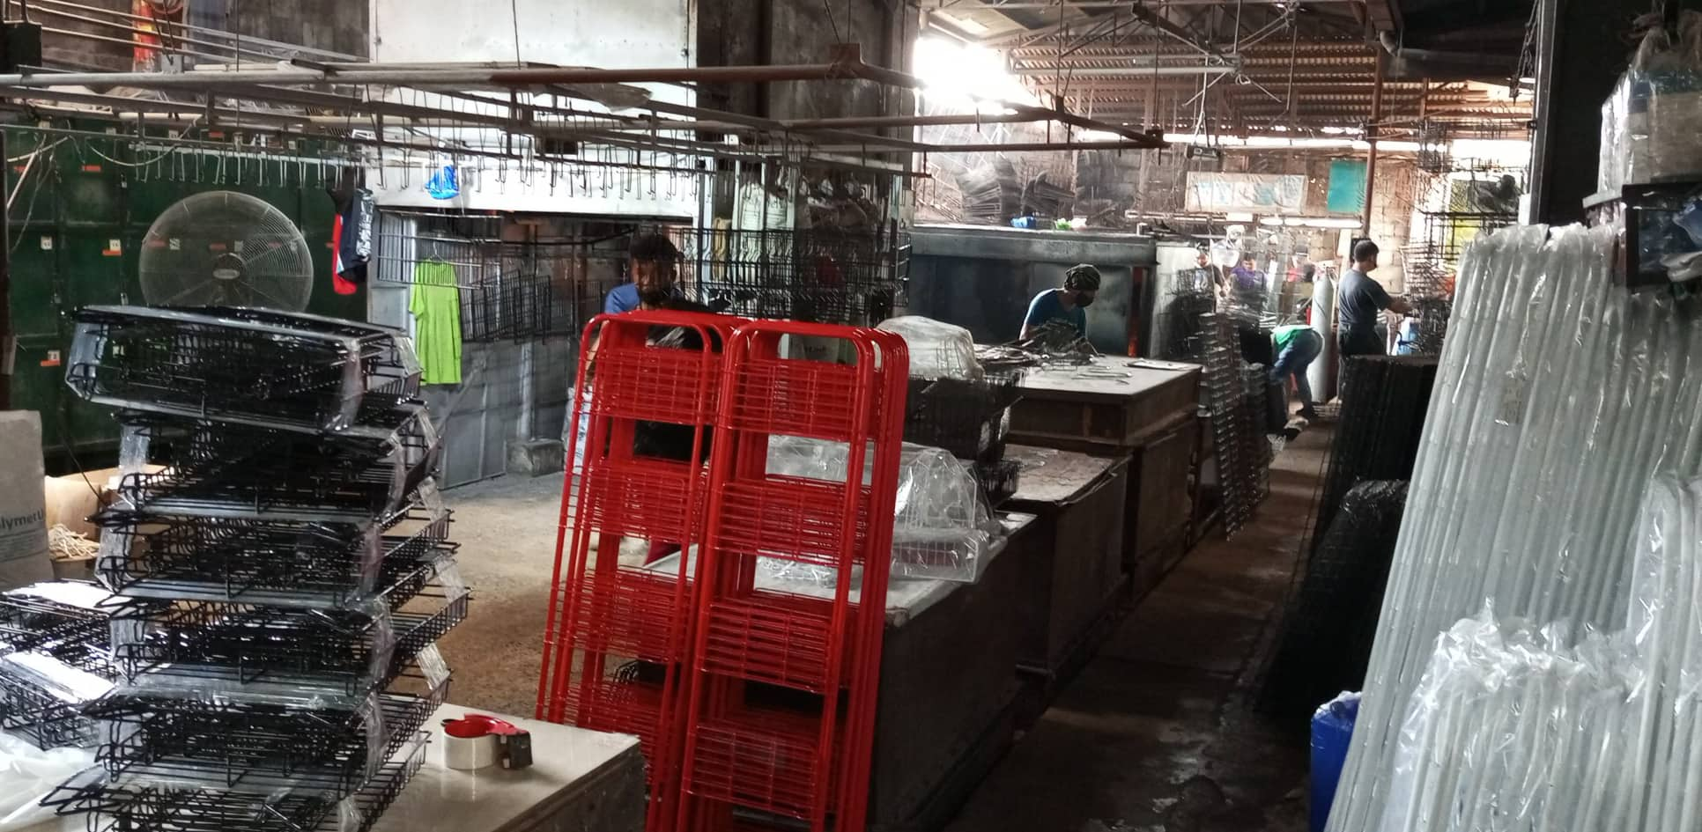
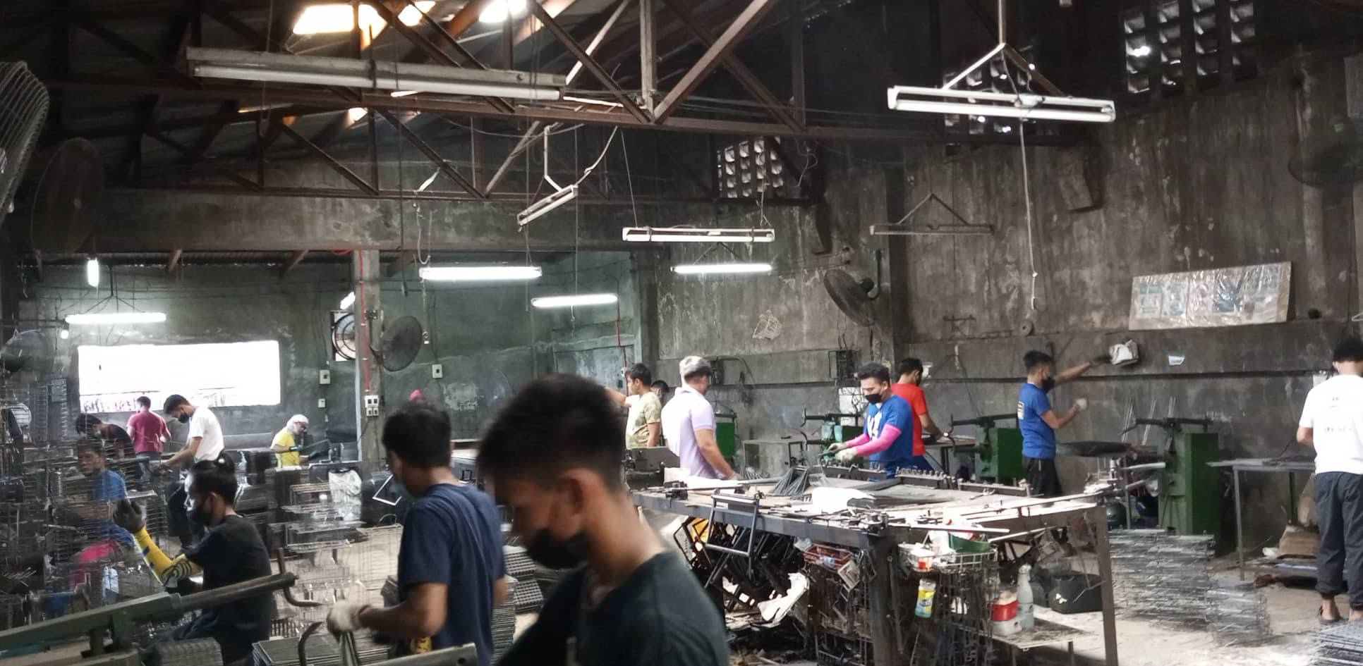
OUR SERVICES

Slide 10
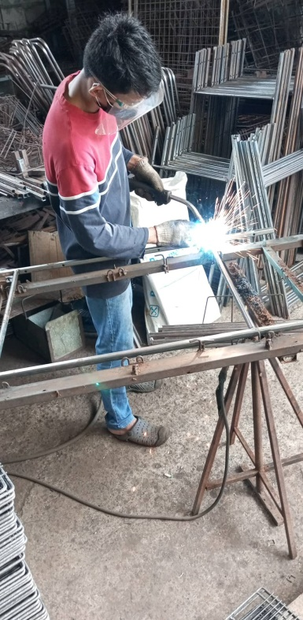
MIG & PLASMA ARC WELDING
OUR SERVICES

Slide 11
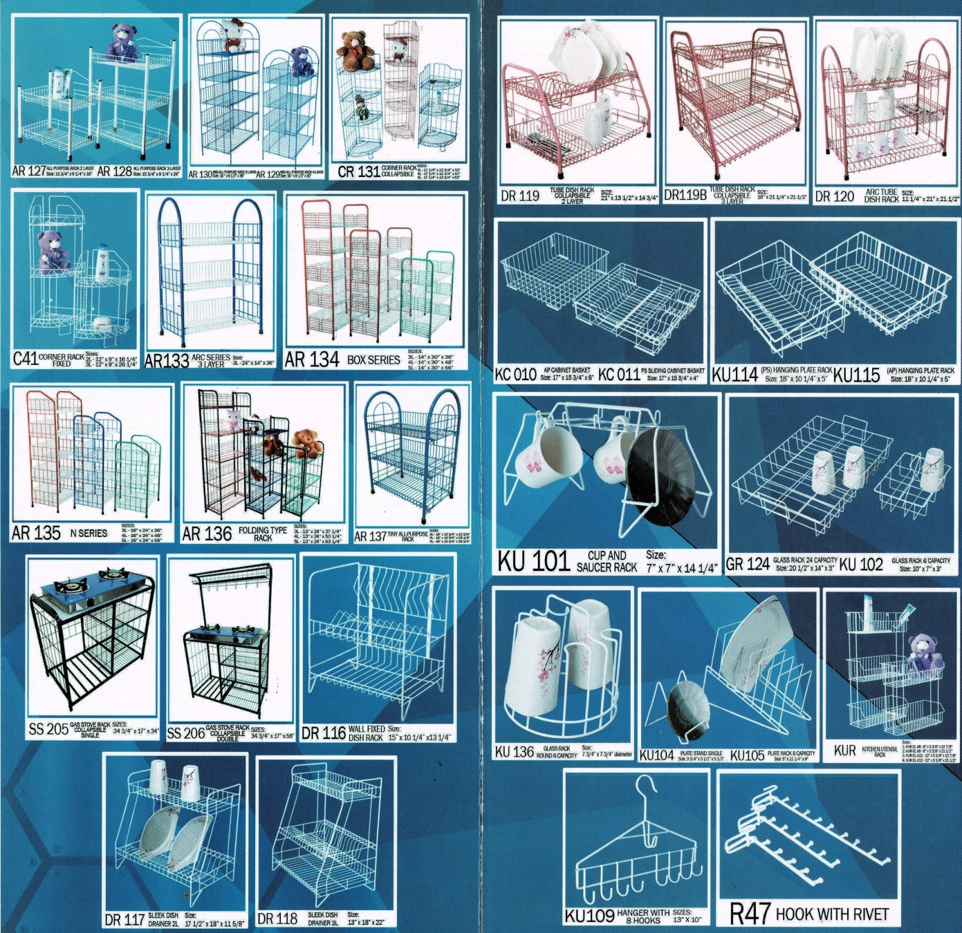
OUR PRODUCTS

Slide 12
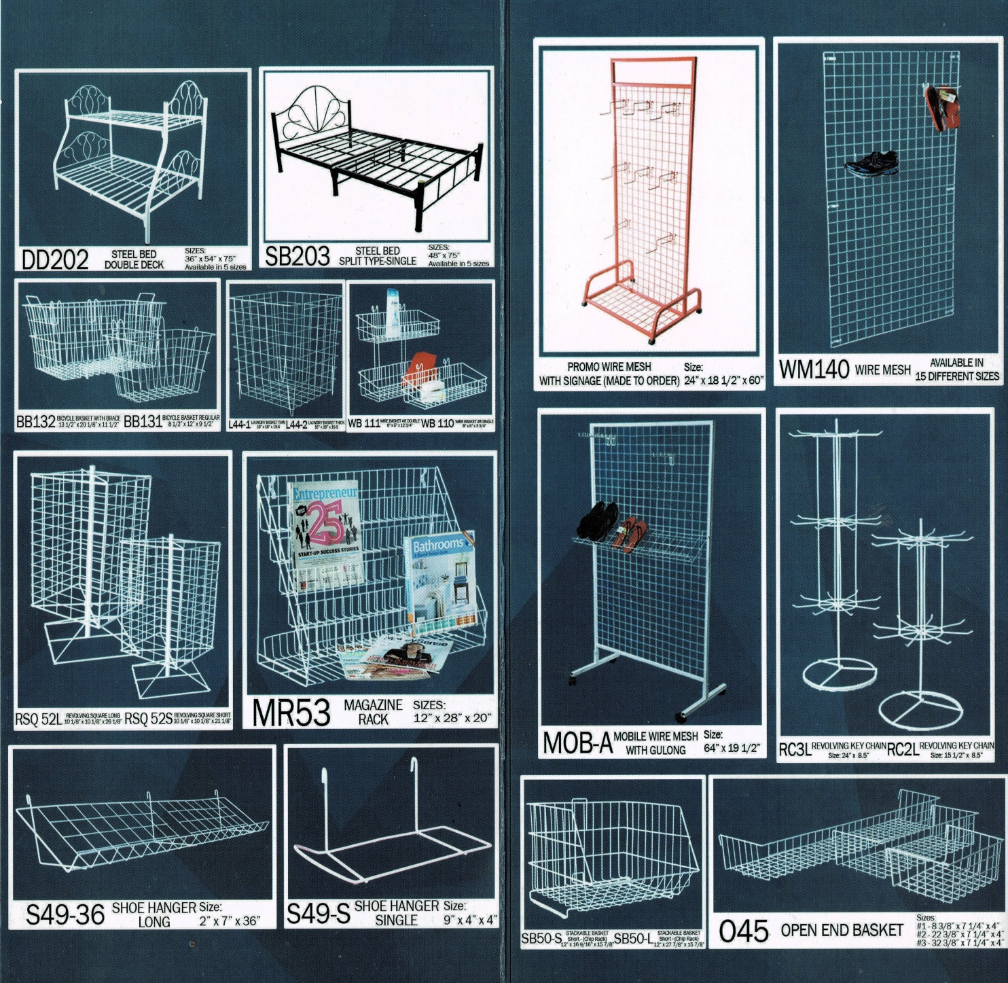
OUR PRODUCTS

Slide 13
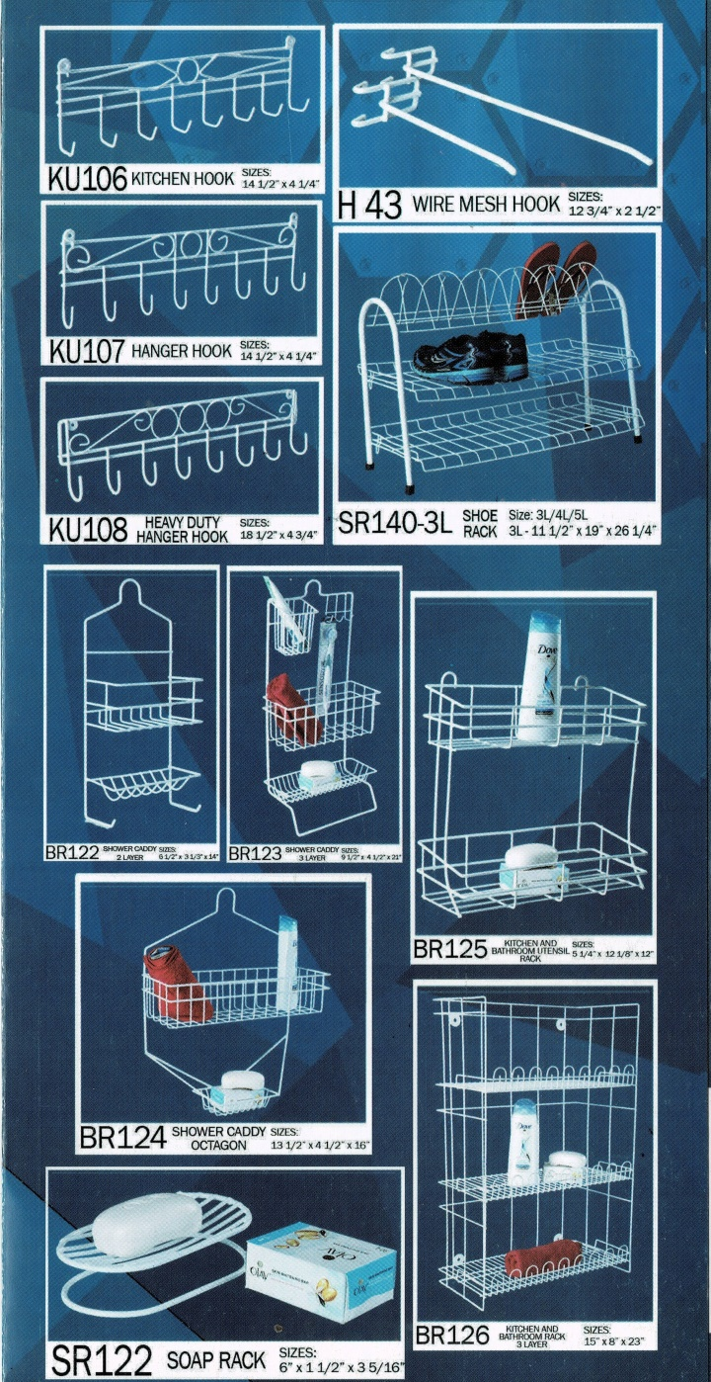
OUR PRODUCTS

Slide 14
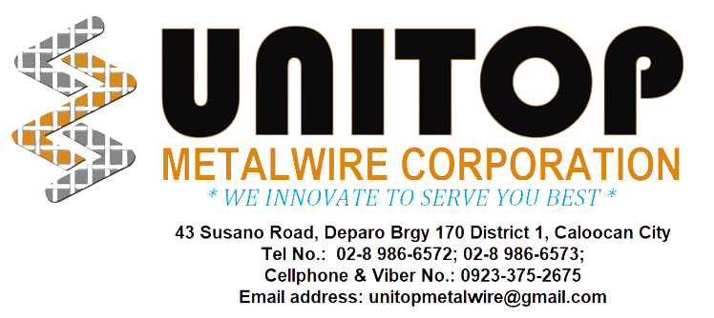









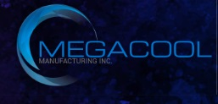

OUR CLIENTS

